Slide 1
Threshold and Multi-Signature Schemes from Linear Hash Functions
Stefano Tessaro, Chenzhi Zhu
University of Washington

Slide 2
This talk is about pairing-free threshold and multi-signatures
Broader library support
Efficient signature verification
Weaker assumptions (DL and RSA)
Notes:
Before we start, I would like to clarify that this talk is about pairing-free threshold and multi-signatures.
Comparing pairing-based schemes to pairing-free schemes, the latter have broader library support, enable more efficient signature verification, and require weaker assumptions, such as DL and RSA.

Slide 3


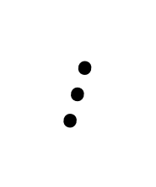

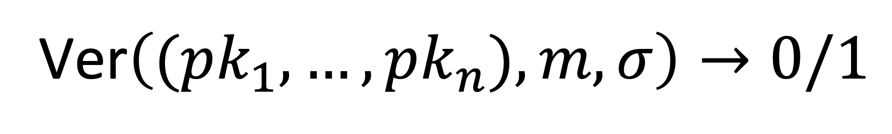
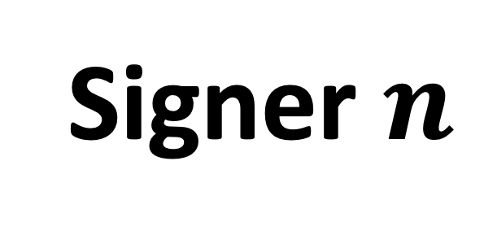
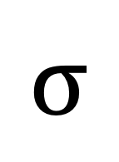
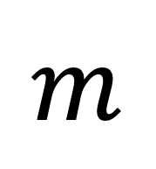
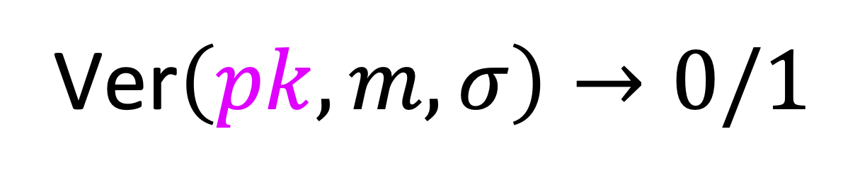
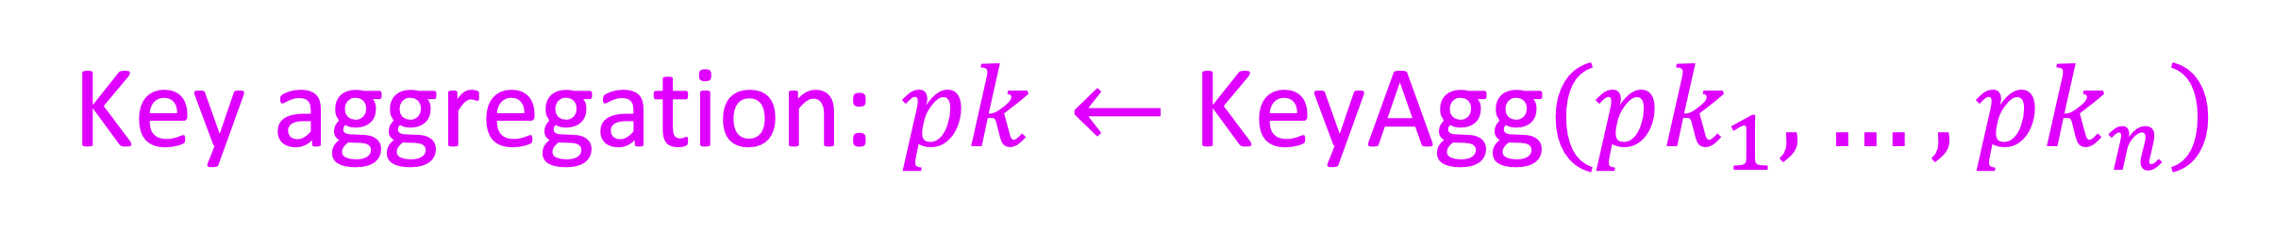
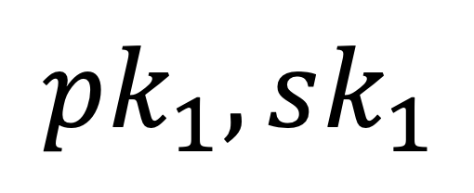
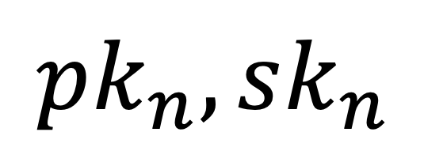

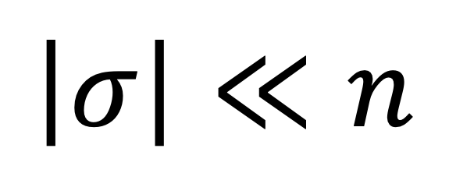
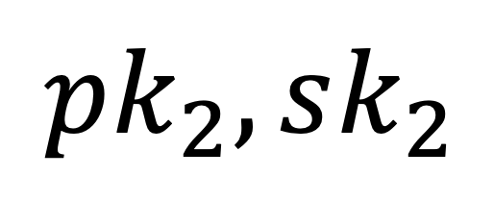
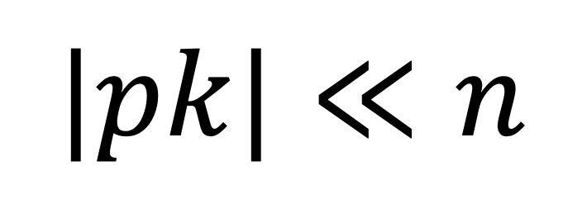
Multi-Signatures [Ita83]
Signer $1$
$$pk_{1},sk_{1}$$
$$m$$
$$\left|σ\right|≪n$$
$$σ$$
$$|pk|≪n$$
$⋮$
User: m
Signer $2$
$$pk_{2},sk_{2}$$
Key aggregation: $pk←$KeyAgg$(pk_{1},…,pk_{n})$
Ver$\left(pk,m, σ\right)→0/1$
Ver$\left((pk_{1},…,pk_{n}), m, σ\right)→0/1$
Signer $n$
$$pk_{n}, sk_{n}$$
Security: valid $σ$ issued if and only if all signers involved
Notes:
I will now introduce the notion of multi-signatures and threshold signatures. In the setting of multi-signatures, the user wants a message to be signed by multiple signers, where each signer has a public and secret key pair.
For signing, the user first sends the message m to one of the signers, and then the signers interact with each other before returning a signature back to the user. The signature can be verified given all the public keys, and we require the size of the signature to be much smaller or independent of the number of signers.
The security requirement here is that the signature is valid if and only if all signers are involved.
Also, practical uses of multi-signature schemes require an additional ideal feature called key aggregation. This feature allows us to aggregate all public keys into a much shorter one that can be used for verification.

Slide 4


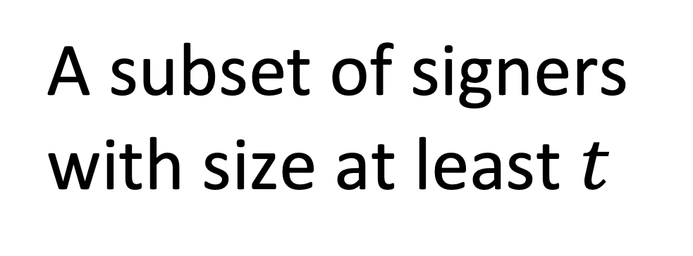

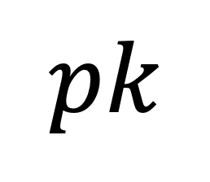
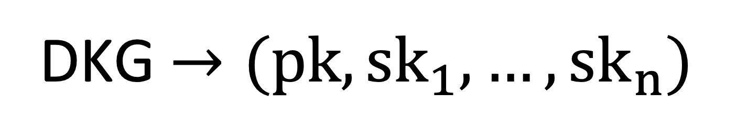
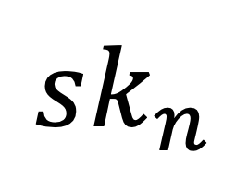
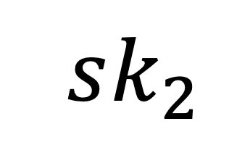
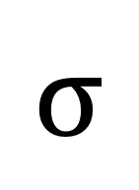
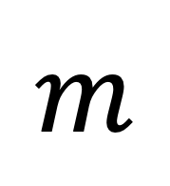
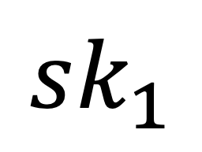
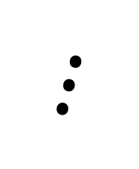
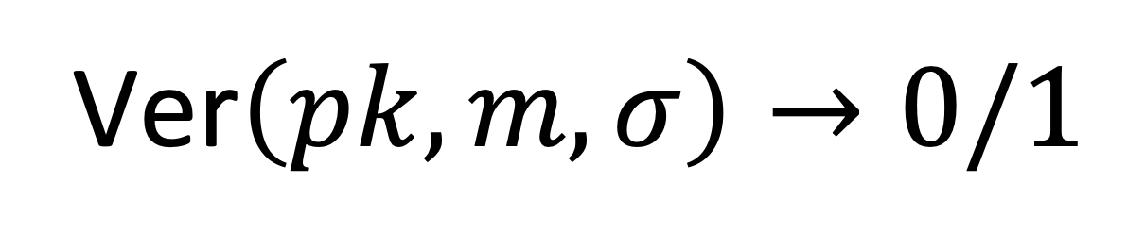

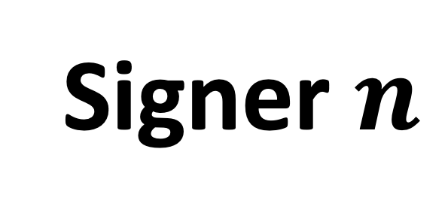
Threshold Signatures [DF90]
Avoid single point of failure
Crypto Wallets
Signer $1$
DKG $→(pk, {sk}_{1}, …,{sk}_{n})$
$$sk_{1}$$
$$m$$
A subset of signers with size at least $t$
$$σ$$
$⋮$
User: m
Signer $2$
$$sk_{2}$$
$$pk$$
NIST and IETF
Standardization
Ver$\left(pk, m, σ\right)→0/1$
Signer $n$
$$sk_{n}$$
Security: valid $σ$ issued if and only if at least $t$ signers involved
Notes:
The setting of threshold signatures is slightly different. In this case, the public key and all the secret keys are generated by a distributed key generation protocol.
Once the user sends the message to one of the signers, a subset of signers with a size at least t are involved in signing and return a signature to the user. The signature can then be verified using the public key.
The security of threshold signatures guarantees that the signature is valid only if at least t signers are involved.
The motivation for using threshold signatures is to avoid single point failure. Research in this area has become increasingly active due to their potential to enhance security in crypto wallets. Recent standardization efforts by NIST and IETF further highlight their importance.

Slide 5
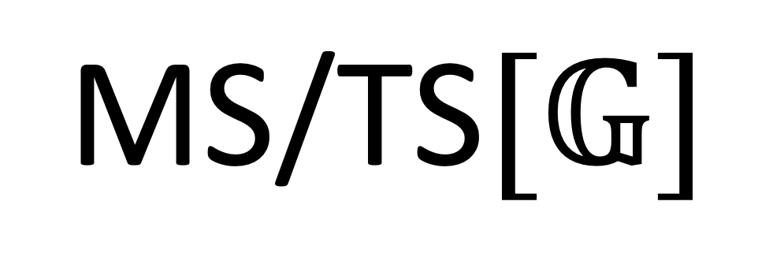
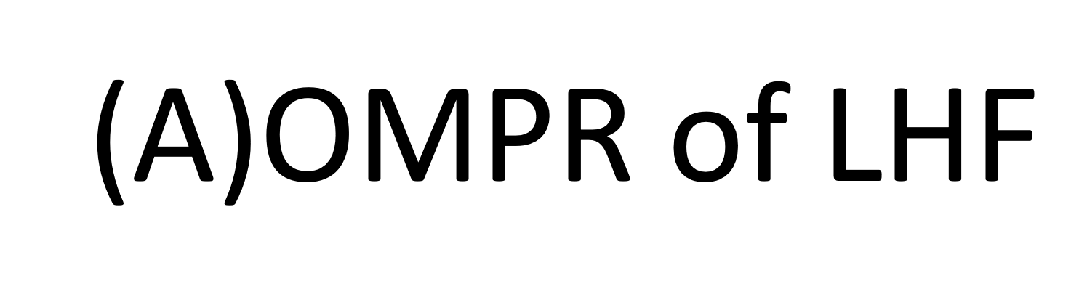
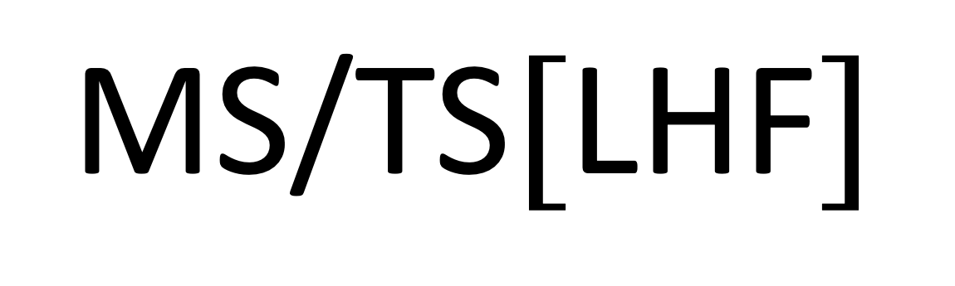
What is this work about?
This work
Security of
Security of
convert
$$\text{MS}\text{/}\text{TS}[𝔾]$$
$$\text{MS}\text{/}\text{TS}[\text{LHF}]$$
(A)OMDL
(A)OMPR of $\text{LHF}$
(Algebraic) one-more DL assumption [BNPS03,NRS21] Stronger than plain DL [KM08]
DL
RSA
Notes:
Then, what is this work about? When investigating the existing group-based construction of MS and TS, we found the most efficient constructions all require the algebraic OMDL assumption, which is suspected to be stronger than the plain DL assumption.
In this work, we demonstrate a rather general conversion that transforms these group-based schemes into ones based on linear hash functions. Moreover, we prove that their security is implied by the algebraic one-more preimage resistance of the underlying linear hash functions, which is a new notion we proposed. Finally, we show that such linear hash functions can be instantiated from either the plain DL assumption or RSA assumption.
As a result, we give new MS/TS constructions that possess the same properties as the original schemes but based only on the DL or RSA assumption, which solves several open problems in the field.
Next, I will present a detailed comparison between our work and prior research.

Slide 6
Prior Works & This Works (Multi-Signatures)
All in random oracle model (ROM)
message-independent
message-dependent
 | Type | Offline Rounds | Online Rounds | Assump- -tions
MuSig2 [NRS21] | MS | 1 | 1 | (A)OMDL
DWMS [AB21] | MS | 1 | 1 | DL+AGM
HBMS [BD21], mBCJ [DEF+19] | MS | 0 | 2 | DL
Chopsticks [PW23] | MS | 0 | 2 | DDH
This work | MS | 1 | 1 | DL/RSA
Partially non-interactive:
1 offline + 1 online
Tight reduction
Only a few RSA MS: either require a trusted third party [DF92,AA05,BJ10], or only sequential signing [Ita83,Oka93,MM00,PLL02]
Notes:
Let’s start from the multi-signatures. We first note that the security of all the schemes we present, including our own, is proved in random oracle model. Here, “offline rounds” refer to rounds that are independent of the message we want to sign, while “online rounds” refer to message-dependent rounds.
Currently, the best we can do is one offline round plus one online round, which is also known as partially non-interactive. However, achieving this requires either algebraic OMDL assumption or assuming the algebraic group model which we wish to avoid.
Prior schemes based on weaker assumptions require at least 2 online rounds, including the Chopsticks scheme, which is presented in the previous talk. However, it should be noted that the advantage of the Chopstick scheme is its tight security reduction.
It is also worth mentioning that there are a few RSA-based multi-signatures, but they either require a trusted third party to generate keys or only support sequential signing, which are undesirable for practical use.

Slide 7
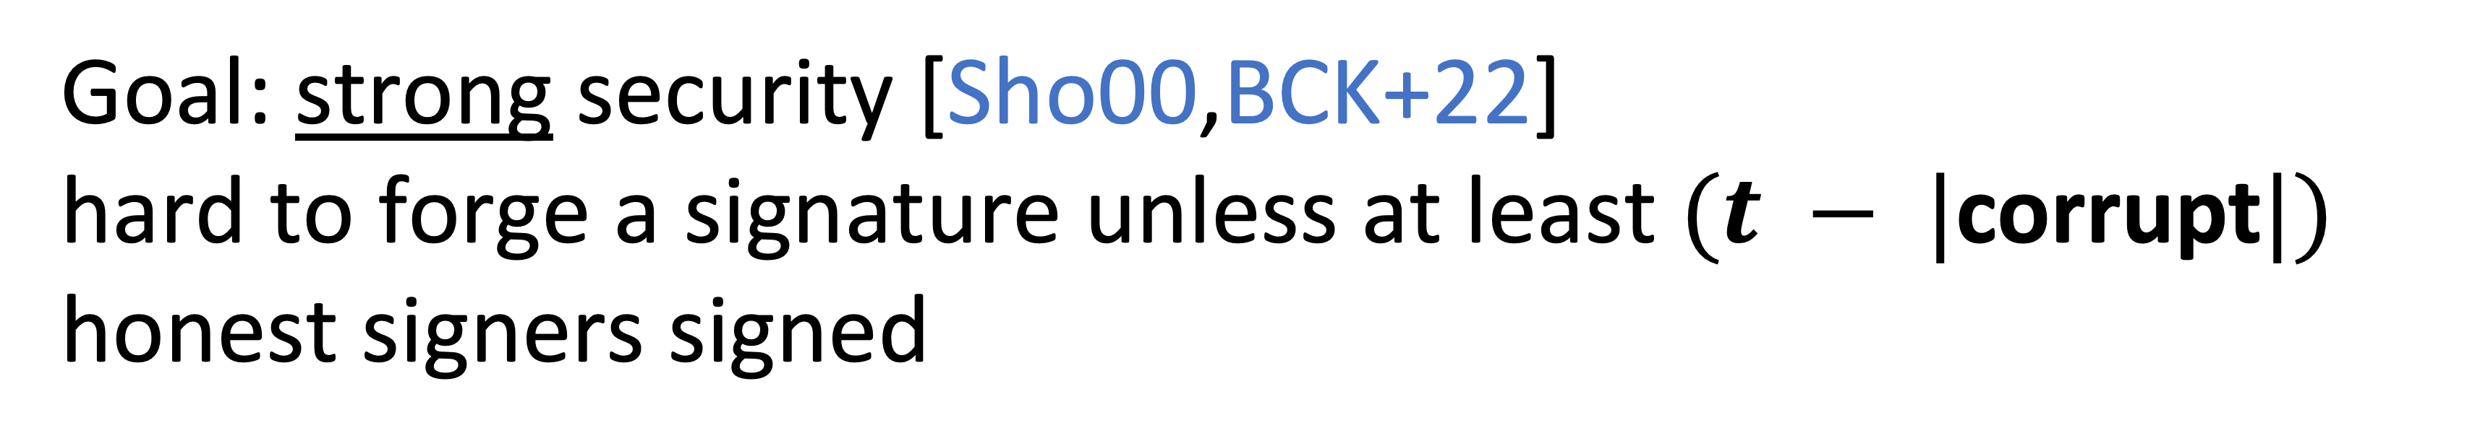
Prior Works & This Works (Threshold Signatures)
All in random oracle model (ROM)
 | Type | Offline Rounds | Online Rounds | Assump- -tions
FROST[KG20, BCK+22] | TS | 1 | 1 | (A)OMDL
[Sho00] | TS | 0 | 1 | RSA+DDH
This work | TS | 1 | 1 | DL/RSA
Shoup’s basic scheme based on RSA only, but with weaker guarantee:
Hard to forge a signature unless one honest signer signed
Goal: strong security [Sho00,BCK+22]
hard to forge a signature unless at least $(t − |\text{corrupt}|)$ honest signers signed
All other RSA TS not for this strong security, though they consider other properties, such as proactivity [Rab98, ADN06], robustness [GJKR96, FMY98, Rab98], removing trusted dealers [DK01, FS01], and adaptive-security [ADN06]
Notes:
For threshold signatures, the only existing provably-secure group-based partially non-interactive scheme is FROST, which requires the algebraic OMDL assumption. Another scheme proposed by Shoup is based on RSA and has a signing protocol consisting of only one online round, but its security relies on the DDH assumption in some integer group, which is not a standard assumption.
It is important to note that in this work, a strong security goal is considered. The adversary should not be able to forge a signature unless at least (t - |corrupt|) honest signers signed.
For weaker guarantees, for example, Shoup’s basic scheme needs only RSA assumption, but its security only guarantees that it is hard to forge a signature unless one honest signer signed.
Furthermore, all other RSA-based threshold signatures do not consider this strong security notion, though they consider other properties, such as proactivity, robustness, removing trusted dealers, and adaptive-security, which are not the focus of this work.

Slide 8
First partially non-interactive TS/MS based only on DL in ROM
First partially non-interactive TS/MS based only on RSA in ROM with the desired security
Notes:
In summary, we propose the first partially non-interactive threshold and multi-signatures based only on DL assumption in the random oracle model.
And we propose the frist partially non-interactive threshold and multi-singatures with desired security based only on RSA assumption in the random oracle model.

Slide 9
For the rest of the talk
1.
This work
Security of
Security of
convert
$$\text{MS}\text{/}\text{TS}[𝔾]$$
$$\text{MS}\text{/}\text{TS}[\text{LHF}]$$
2.
(A)OMDL
(A)OMPR of $\text{LHF}$
DL
RSA
Notes:
For the rest of the talk, I will first recall the concept of linear hash functions and describe how our conversions work. Then, I will focus on how to instantiate the one-more preimage-resistance property from the DL or RSA assumption.

Slide 10
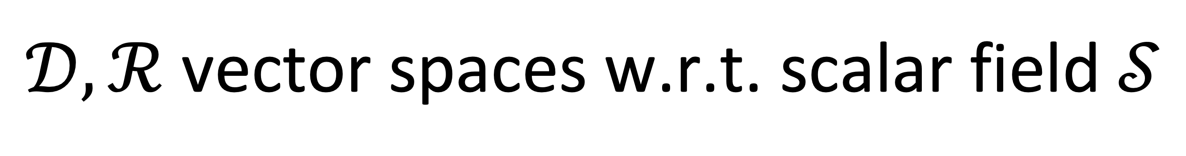
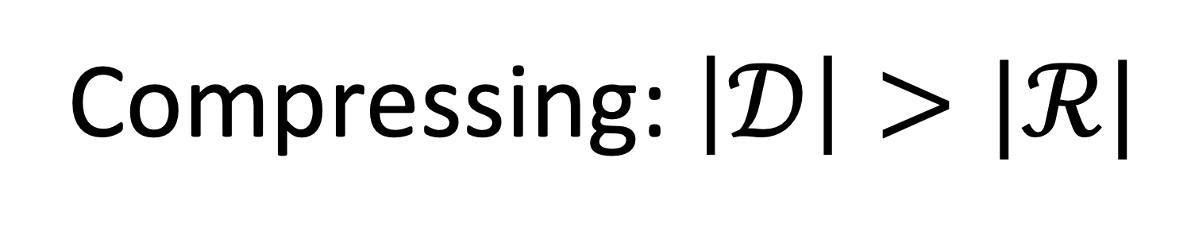
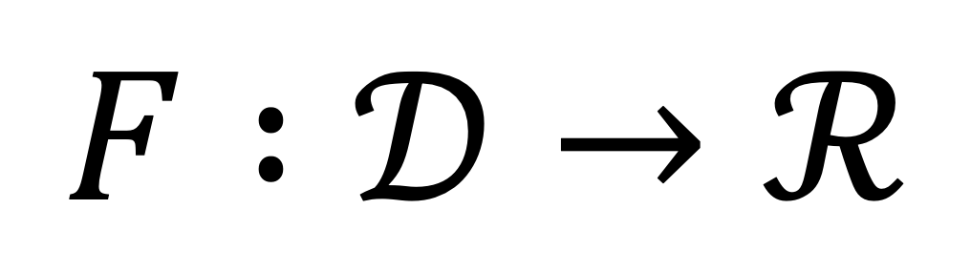
Linear Hash Functions [BBSS18,HKL19]
Surjective function
$$F :𝒟→ℛ$$
Compressing: $\left|𝒟\right|>|ℛ|$
$𝒟, ℛ$ vector spaces w.r.t. scalar field $𝒮$
Linear:
$$∀ a, b∈𝒟 , s∈𝒮, F\left(a+s⋅b\right)=F\left(a\right)+s⋅F\left(b\right)$$
Collision Resistance (CR): Hard to find $x≠x^{′}∈𝒟$ s.t. $F\left(x\right)=F(x′)$
Notes:
A linear hash function is a function from domain D to range R, where D and R are vector spaces w.r.t. a scalar field S. We require the function to be surjective and compressing, i.e. the range size is smaller than the domain size.
In addition, we require the function to be linear and collision resistance.
Intuitively, a linear hash function is a collision resistance hash function with linear structure.

Slide 11
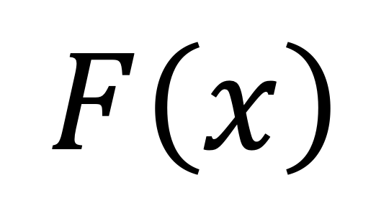
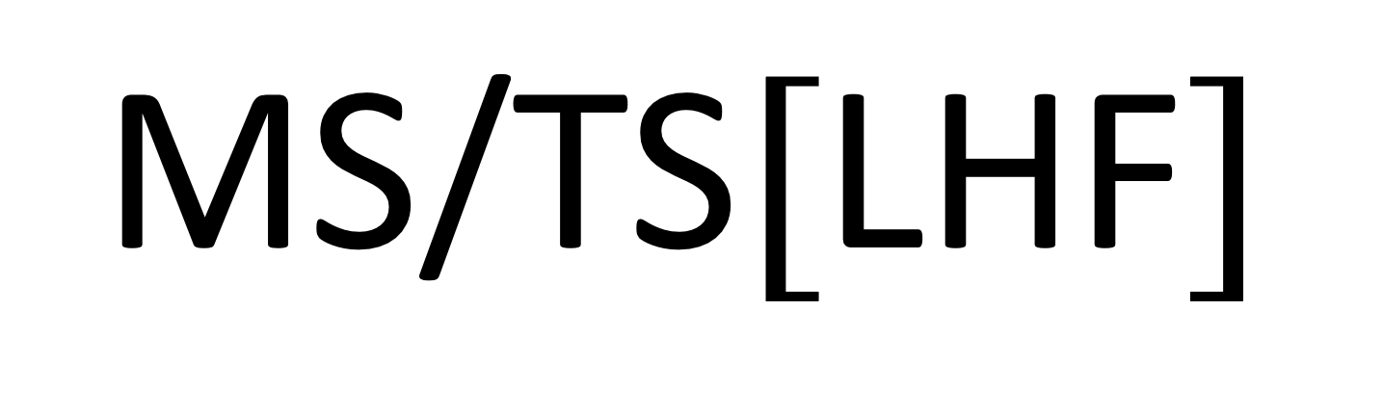


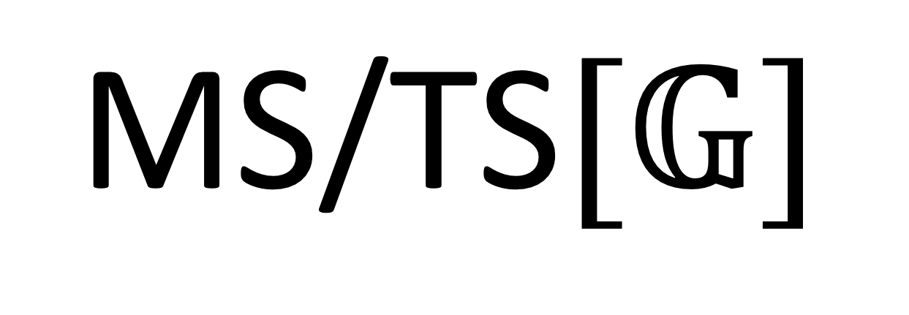

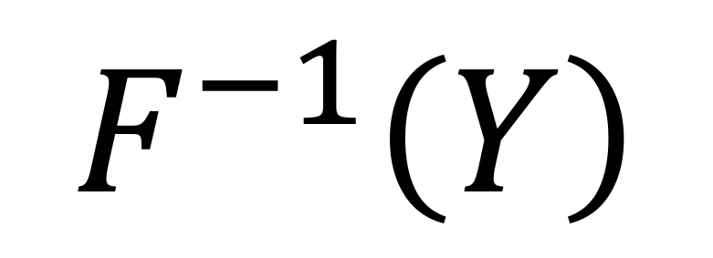
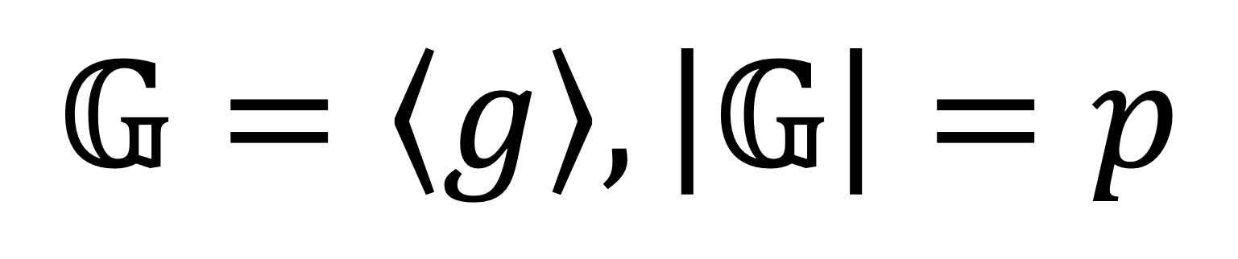
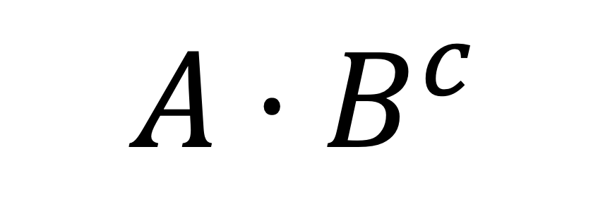
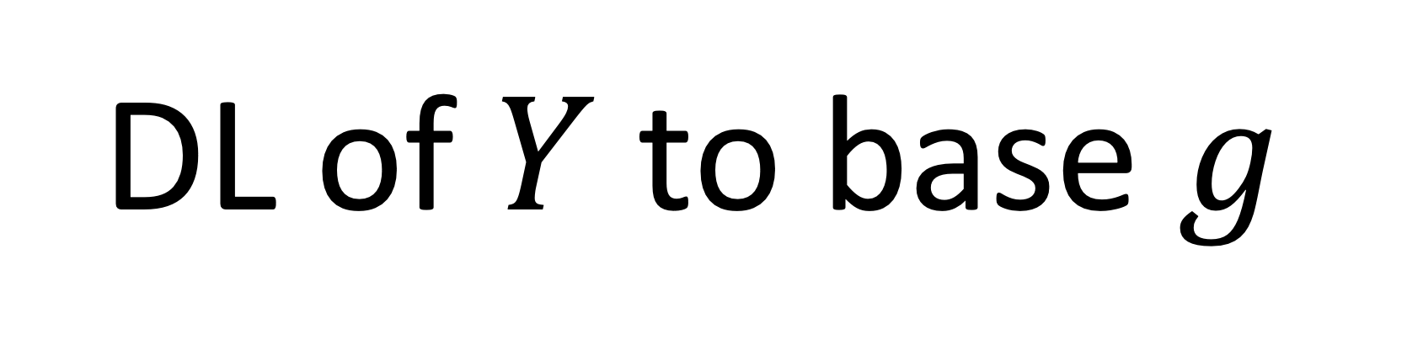
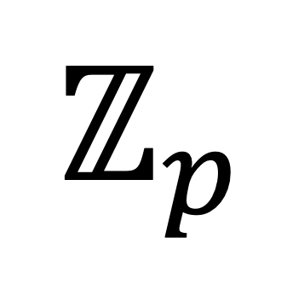
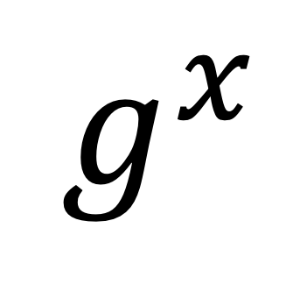
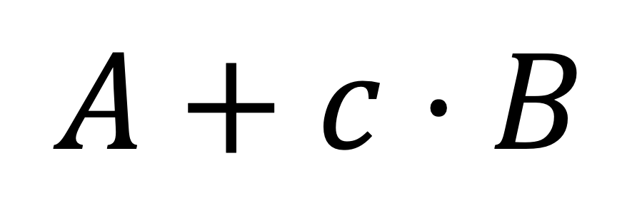
Our Idea: Replacing group with LHF
convert
$$\text{MS}\text{/}\text{TS}[𝔾]$$
$$\text{MS}\text{/}\text{TS}[\text{LHF}]$$
$$g^{x}$$
$$F\left(x\right)$$
$$𝔾=\left\langle g\right\rangle , \left|𝔾\right|=p$$
$$ℤ_{p}$$
$$𝒟$$
$$𝔾$$
$$ℛ$$
$$A⋅B^{c}$$
$$A+c⋅B$$
DL of $Y$ to base $g$
$$F^{−1}\left(Y\right)$$
Notes:
I will now show how we do the conversion.
The idea is simple. given a cyclic group with generator g and size p, we replace all group exponentiations g^x with the linear hash function F(x). Correspondingly, we replace Z_p with domain D, replace group G with range R, replace group operations with operations in R. And the discrete log of Y to base g is corresponding to the pre-image of Y under F.

Slide 12

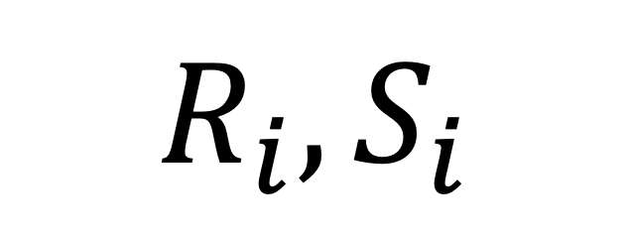

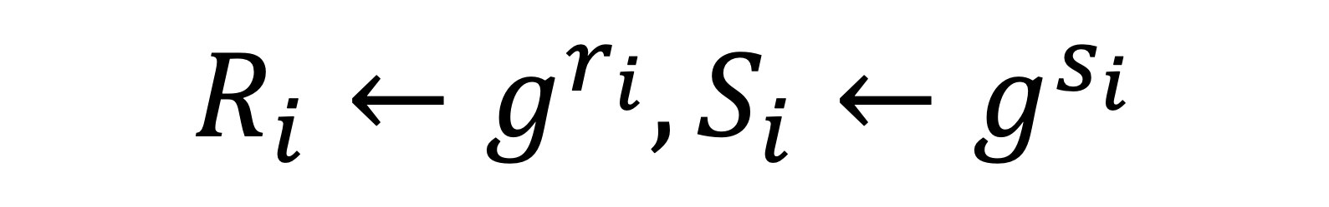

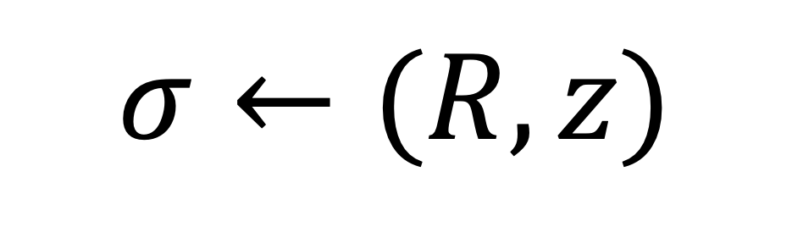
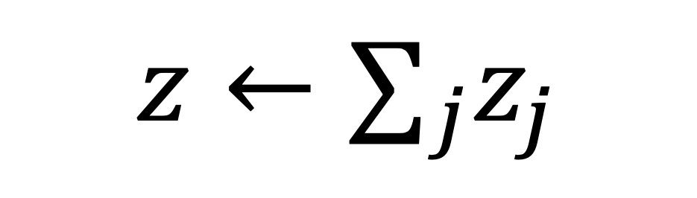
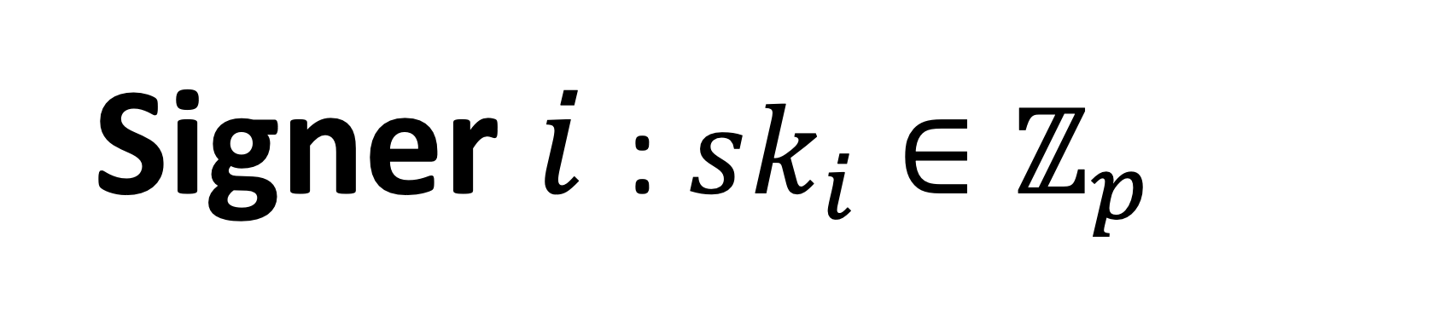

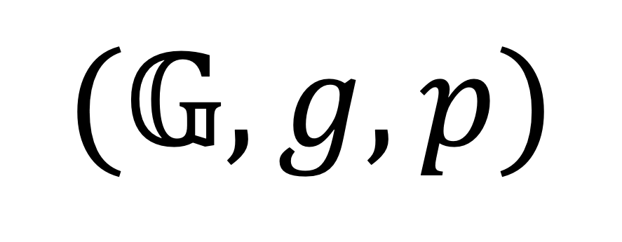
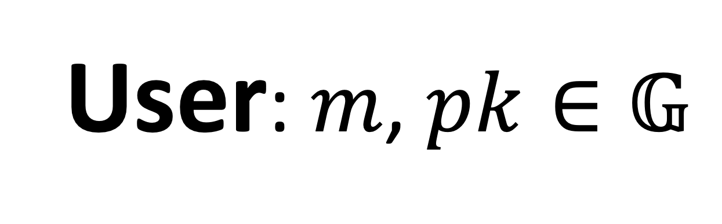

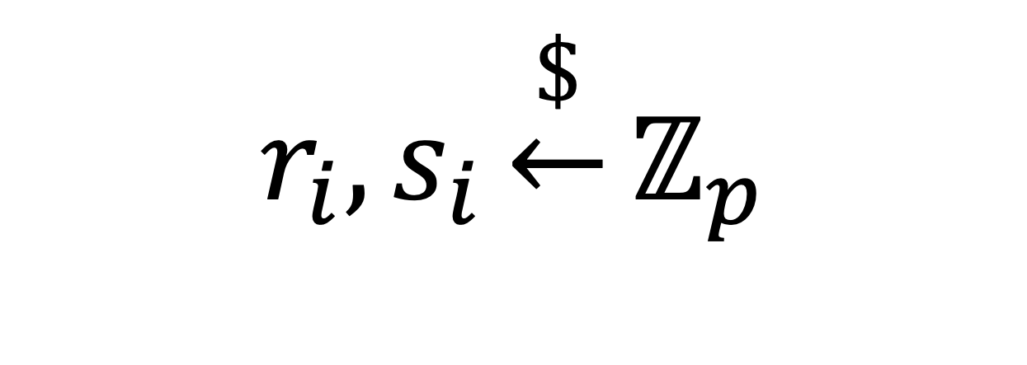

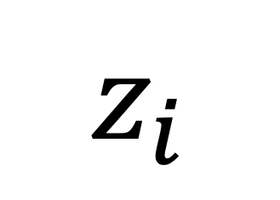
Example: $\text{FROST}[𝔾]$
$$(𝔾, g, p)$$
Signer $i$ : $sk_{i}∈ℤ_{p}$
User: $m$, $pk∈𝔾$
$$r_{i}, s_{i}\underset{←}{\$}ℤ_{p}$$
$$R_{i},S_{i}$$
$$R_{i}←g^{r_{i}}, S_{i}←g^{s_{i}}$$
$$m,lr=\{(R_{j},S_{j})\}$$
$$d←H_{1}(pk, lr)$$
$$z←∑_{j}z_{j}$$
$$R←∏_{\left(R_{j},S_{j}\right)∈lr }R_{j}S_{j}^{d}$$
$$z_{i}$$
$$c←H_{2}(pk, m,R)$$
$$σ←(R, z)$$
$$z_{i}←r_{i}+ds_{i}+cλ_{i}sk_{i}$$
Notes:
Let’s take FROST scheme as an example. Here is the signing protocol of FROST.

Slide 13
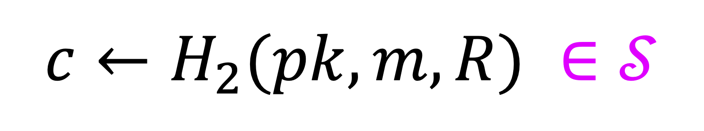







Example: $\text{FROST}[\text{LHF}]$
$$(𝒟,ℛ,𝒮,F)$$
Signer $i$ : $sk_{i}∈𝒟$
User: $m$, $pk∈𝔾$
$$r_{i}, s_{i}\underset{←}{\$}𝒟$$
$$R_{i},S_{i}$$
$$R_{i}←F(r_{i}), S_{i}←F(s_{i})$$
$$m,lr=\{(R_{j},S_{j})\}$$
$$d←H_{1}\left(pk, lr\right)∈𝒮$$
$$z←∑_{j}z_{j}$$
$$R←∑_{\left(R_{j},S_{j}\right)∈lr }R_{j}+dS_{j}$$
$$z_{i}$$
$$c←H_{2}(pk, m,R) ∈𝒮$$
$$σ←(R, z)$$
$$z_{i}←r_{i}+ds_{i}+cλ_{i}sk_{i}$$
Notes:
Here is the scheme after transformation. I will not go into further detail. Rather, I just want to give you an idea of how the conversion looks like

Slide 14









Signatures produced by $\text{FROST}\left[\text{LHF}\right]:$
$\left(m,σ=\left(A,z\right)\right)$ is valid for $pk∈ℛ$
$$⇔$$
$$F\left(z\right)=A+H_{2}\left(pk,m,A\right)⋅pk$$
$Z$ another generator
DL instantiation: given$\left(𝔾, g, p\right), Z$
$$𝒟≔ℤ_{p}^{2},ℛ≔𝔾,S≔ℤ_{p}$$
$$F:\left(x_{1},x_{2}\right)↦g^{x_{1}}Z^{x_{2}}$$
$\left(m,σ=\left(A,a,b\right)\right)$ is valid for $pk∈𝔾$
$$⇔$$
$$g^{a}Z^{b}=A⋅pk^{H_{2}\left(pk,m,A\right)}$$
Okamoto’s signatures [Oka93]
Notes:
I also want to briefly highlight the resulting signature here
In particular, for the DL instantiation of the linear hash function used, the signature produced is as follows, which is exactly Okamoto’s signatures.

Slide 15




Security of $\text{FROST}[\text{LHF}]$
Security of
Security of
convert
$$\text{FROST}[𝔾]$$
$$\text{FROST}[\text{LHF}]$$
[BCK+22]
convert
(A)OMDL
(A)OMPR of $\text{LHF}$
(Algebraic) One-More Preimage Resistance
Notes:
To show the security of LHF-based FROST, the idea is to apply the same conversion to both the assumption and reduction. The original proof shows the security of FROST is implied by algebraic omdl assumption. Using the conversion described earlier, we transform the assumption to the algebraic one-more PR of the linear hash function.
Then, we show the security of LHF-based FROST is implied by the algebraic one-more PR by adapting the original proof.
I won't delve into how we adapt the proof here due to time constraints. Rather, I will briefly explain how we derive the notion of algebraic one-more PR

Slide 16













OMDL [BPNS03]
(Algebraic) OMDL [NRS21]
$$x_{1},…,x_{n}\underset{←}{\$}ℤ_{p}$$
$$(𝔾, g, p)$$
$$X_{1}, …,X_{n}$$
$X_{i}←g^{x_{i}}$ for all $i$
$$, \vec{α}$$
$$Y∈𝔾$$
$$Y=X_{1}^{α_{1}}⋯X_{n}^{α_{n}}$$
$$y$$
DL
$$y=\sum_{i}{α_{i}x_{i}}$$
$$Y=g^{y}$$
$${\hat{x}}_{1},…,{\hat{x}}_{n}$$
Adversary wins if $X_{i}=g^{{\hat{x}}_{i}}$ for all $i$ and # of DL queries $<n$
Falsifiable
Notes:
Let's begin by reviewing the OMDL assumption. It is defined using the following game.
The challenger first generates n random group elements X1 to Xn as challenges and sends them to the adversary. The adversary has access to a DL oracle, which can take any group element as input and returns its DL to base g. The adversary's goal is to compute the DLs of all the challenges. The adversary wins if all DLs are computed correctly and the total number of DL queries made by the adversary is less than n.
The algebraic one-more DL assumption is a weaker variant, where the crucial difference is that when the adversary makes a DL query, they must also provide a representation of the input Y w.r.t. to all challenges. Notably, the DL oracle can be implemented efficiently in this case, as the challenger can compute y as the sum of alpha_i times x_i, which means the assumption is falsifiable.

Slide 17









(Algebraic) OMPR [This work]
(Preimage Resistance)
$$x_{1},…,x_{n}\underset{←}{\$}𝒟$$
$$(𝒟,ℛ,𝒮,F)$$
$$X_{1}, …,X_{n}$$
$X_{i}←F(x_{i})$ for all $i$
$$Y∈ℛ$$
$$, \vec{α}$$
$$Y=\sum_{i}{a_{i}X_{i}}$$
$$y$$
PI
$$Y=F(y)$$
$$y=\sum_{i}{α_{i}x_{i}}$$
$${\hat{x}}_{1},…,{\hat{x}}_{n}$$
Adversary wins if $X_{i}=F({\hat{x}}_{i})$ for all $i$ and # of PI queries $<n$
Notes:
Then, using our conversion, we adapt the algebraic OMDL game to the LHF setting,
The DL oracle is replaced by the preimage oracle, which takes an element Y in R as input and returns a corresponding small y which is in the preimage of Y. To query the preimage oracle, the adversary must provide a representation alpha of Y, and thus small y can be computed efficiently given alpha and the previously generated small x_i values.
The goal of the adversary is to find an element in the preimage of each challenge using fewer than n PI queries. Therefore, we refer to the game as the algebraic one-more preimage resistance game.

Slide 18



How to construct LHF such that (A)OMPR is implied by DL or RSA?
(A)OMPR of $\text{LHF}$
[This work]
CR of $\text{LHF}$
DL instantiation:
$$F:\left(x_{1},x_{2}\right)↦g^{x_{1}}Z^{x_{2}}$$
[HKL19]
DL
RSA
Notes:
Now the main challenge is to construct LHF such that its OMPR is implied by DL or RSA assumption. We achieve this goal through a two-step process. In the first step, we show algebraic one-more PR is implied by collision resistance of the LHF. Then, the second step is to construct LHF such that the collision resistance property is implied by DL or RSA.
Our main contribution is the first step. For the second step, we adopt existing instantiations from prior works, such as the DL instantiation mentioned earlier.

Slide 19


Collision Resistence (CR) implies (A)OMPR [This work]
Theorem. For any (A)OMPR adversary $𝒜$, there exists a CR adversary $ℬ$
$${\text{A}\text{dv}}_{\text{LHF}}^{\text{aompr}}\left(𝒜\right)≤2{\text{Adv}}_{\text{LHF}}^{\text{cr}}(ℬ)$$
Notes:
For the rest of the talk, I will focus on how to show AOMPR is implied by collision resistance.
Formally, we show the following theorem: for any AOMPR adversary A there exists an adversary B for breaking collision resistance such that A's advantage is no greater than twice the advantage of B..

Slide 20














Construction of $ℬ$
$ℬ$ faithfully simulates AOMPR game
$$(𝒟,ℛ,𝒮,F)$$
$$ℬ$$
$$x_{1},…,x_{n}\underset{←}{\$}𝒟$$
$$X_{1}, …,X_{n}$$
$X_{i}←F(x_{i})$ for all $i$
$$𝒜$$
$$Y$$
$$, \vec{α}$$
$$y=\sum_{i}{α_{i}x_{i}}$$
How to show it occurs with high probability?
$$y$$
PI
If $𝒜$ wins and ${\hat{x}}_{i}≠x_{i}$ for some $i$, $ℬ$ finds a collision $(x_{i},{\hat{x}}_{i})$
$${\hat{x}}_{1},…,{\hat{x}}_{n}$$
Notes:
The construction of B is straightforward. B runs A by faithfully simulates the one-more PR game. More precisely, intially, B generates and sends challenges to the adversary exactly as in the OMPR game. Then, for each preimage query, B responds with an answer also follows the OMPR game.
If A wins the game and one of A’s output elements differs from the one sampled by B, B finds a collision since both small x_i hat and small x_i are in the preimage of X_i.
Therefore, we just need to show this deviation occurs with high probability.

Slide 21


















Observation. The execution of $ℬ$ determined by $\vec{x}=(x_{1},…,x_{n})$
For $\vec{x}$ that makes $𝒜$ win
construct $Φ$ maping $\vec{x}$ to a different $\vec{x}′$ s.t.
$$ℬ$$
The proof goes through if $Φ$ is a bijection
$$ℬ$$
$$\vec{x}$$
$${\text{View}}_{𝒜}\left(\vec{x}\right)$$
$$\vec{x}′$$
$$𝒜$$
$$⋯$$
$$=$$
$$𝒜$$
$$⋯$$
$${\text{View}}_{𝒜}\left(\vec{x}′\right)$$
$${\hat{x}}_{1},…,{\hat{x}}_{n}$$
$${\hat{x}}_{1},…,{\hat{x}}_{n}$$
Thus, either $\vec{x}≠({\hat{x}}_{1},…,{\hat{x}}_{n})$ or $\vec{x}′≠({\hat{x}}_{1},…,{\hat{x}}_{n})$
$ℬ$ wins in one of the two!
Notes:
One key observation is that the execution of B is completely determined by small x_i values sampled initially.
For any x that makes A win, in order to show that the output of A differs from x, the idea is to construct a function Phi that maps vector x to a different vector, x’, such that A’s view given x is identical to its view given x’. This implies that A’s output is identical in both cases and thus either x or x’ is not equal to A’s output. Hence, B wins in one of the two cases.
Finally, it is not hard to see that the proof goes through if Phi is a bijection.

Slide 22










How to construct $Φ$?
$z^{∗}$ exists since $F$ is many-to-one
$z^{∗}≠0∈𝒟$ such that $F(z^{∗})=0$
$$Φ\left(\vec{x}\right)≔\vec{x}+\vec{b}⋅z^{∗}$$
$\vec{b}$ exists since # of PI queries $<n$
$\vec{b}≠\vec{0}∈𝒮^{n}$ such that $\left\langle \vec{α},\vec{b}\right\rangle =0$ for any $(Y, \vec{α})$ query made by $𝒜$
Why ${\text{View}}_{𝒜}\left(\vec{x}\right)={\text{View}}_{𝒜}\left(Φ(\vec{x})\right)$?
$𝒜$ receives the same challenges
$F\left(Φ(\vec{x})\right)=F\left(\vec{x}+\vec{b}⋅z^{∗}\right)=F\left(\vec{x}\right)+\vec{b}⋅F\left(z^{∗}\right)=F(\vec{x})$
$𝒜$ receives the same answers for all queries
$\sum_{i}{α_{i}Φ{\left(\vec{x}\right)}_{i}}=\left\langle \vec{α},\vec{b}\right\rangle ⋅z^{∗}+ \sum_{i}{α_{i}x_{i}}=\sum_{i}{α_{i}x_{i}}$
Notes:
It is left to show how to construct such a Phi.
Our construction is as follows, where z^* is a non-zero element in D that maps to 0 by F. Such z* must exist since F is many to one. Also, b is a non zero vector in S such that the inner product of b and any representation alpha provided by A for PI queries is 0.
To see why A’s view given x is identical to its view given Phi(x), we only need to show that A receives the same challenges and query answers in both cases.
First, A receives the same challenges since F(Phi(x)) is equal to F(x), where the last equality holds because F(z*) = 0.
Second, A receives the same answers for all queries since the term alpha inner product b is equal to 0 for all PI queries.
We can also show Phi is a bijection, but I will not delve into the proof due to time constraints.

Slide 23
Future Directions
Extend our results to post-quantum setting?
Remove (A)OMDL assumption for others?
Notes:
Finally, I would like to mention a few future directions. One of them is to investigate the extension of our framework to the post-quantum setting, with the aim of achieving better post-quantum secure TS/MS schemes. Another direction is to identify additional areas where we can use our techinques to remove algebraic OMDL asusmption.

Slide 24
Thank you!
Our Paper : https://eprint.iacr.org/2023/276.pdf

